Slide 1
Understanding Electrical Safety: Hazard, Risk & Mitigation Strategies

Slide 2
Preview
Electrical Safety by the Numbers
Understanding Hazard v/ Risk
Risk Management Strategies
Notes:
Thanks for your time today. I understand that we have X min with Y minutes of Q&A – correct?
OK, What I plan to discuss with you today is
-- an Overview of Electrical Safety, and what makes it a totally different animal than other Hazards that you are confronted with in the workplace
-- an Overview of Hazard and Risk – what the difference is, where they overlap, why it matters
-- an Overview of what Risk Mitigation is, what this foundational concept means for your electrical safety program
Is that about what you were expecting?
Is there anything else you’d like to discuss?
Anything you want me to address while you have me?
…Great, then first -- Who am I? Why am I qualified to talk with you about this?

Slide 3
H E L L O
My Name Is
TIM
Notes:
Brief Bio

Slide 4
Electrical Safety Statistics

Slide 5
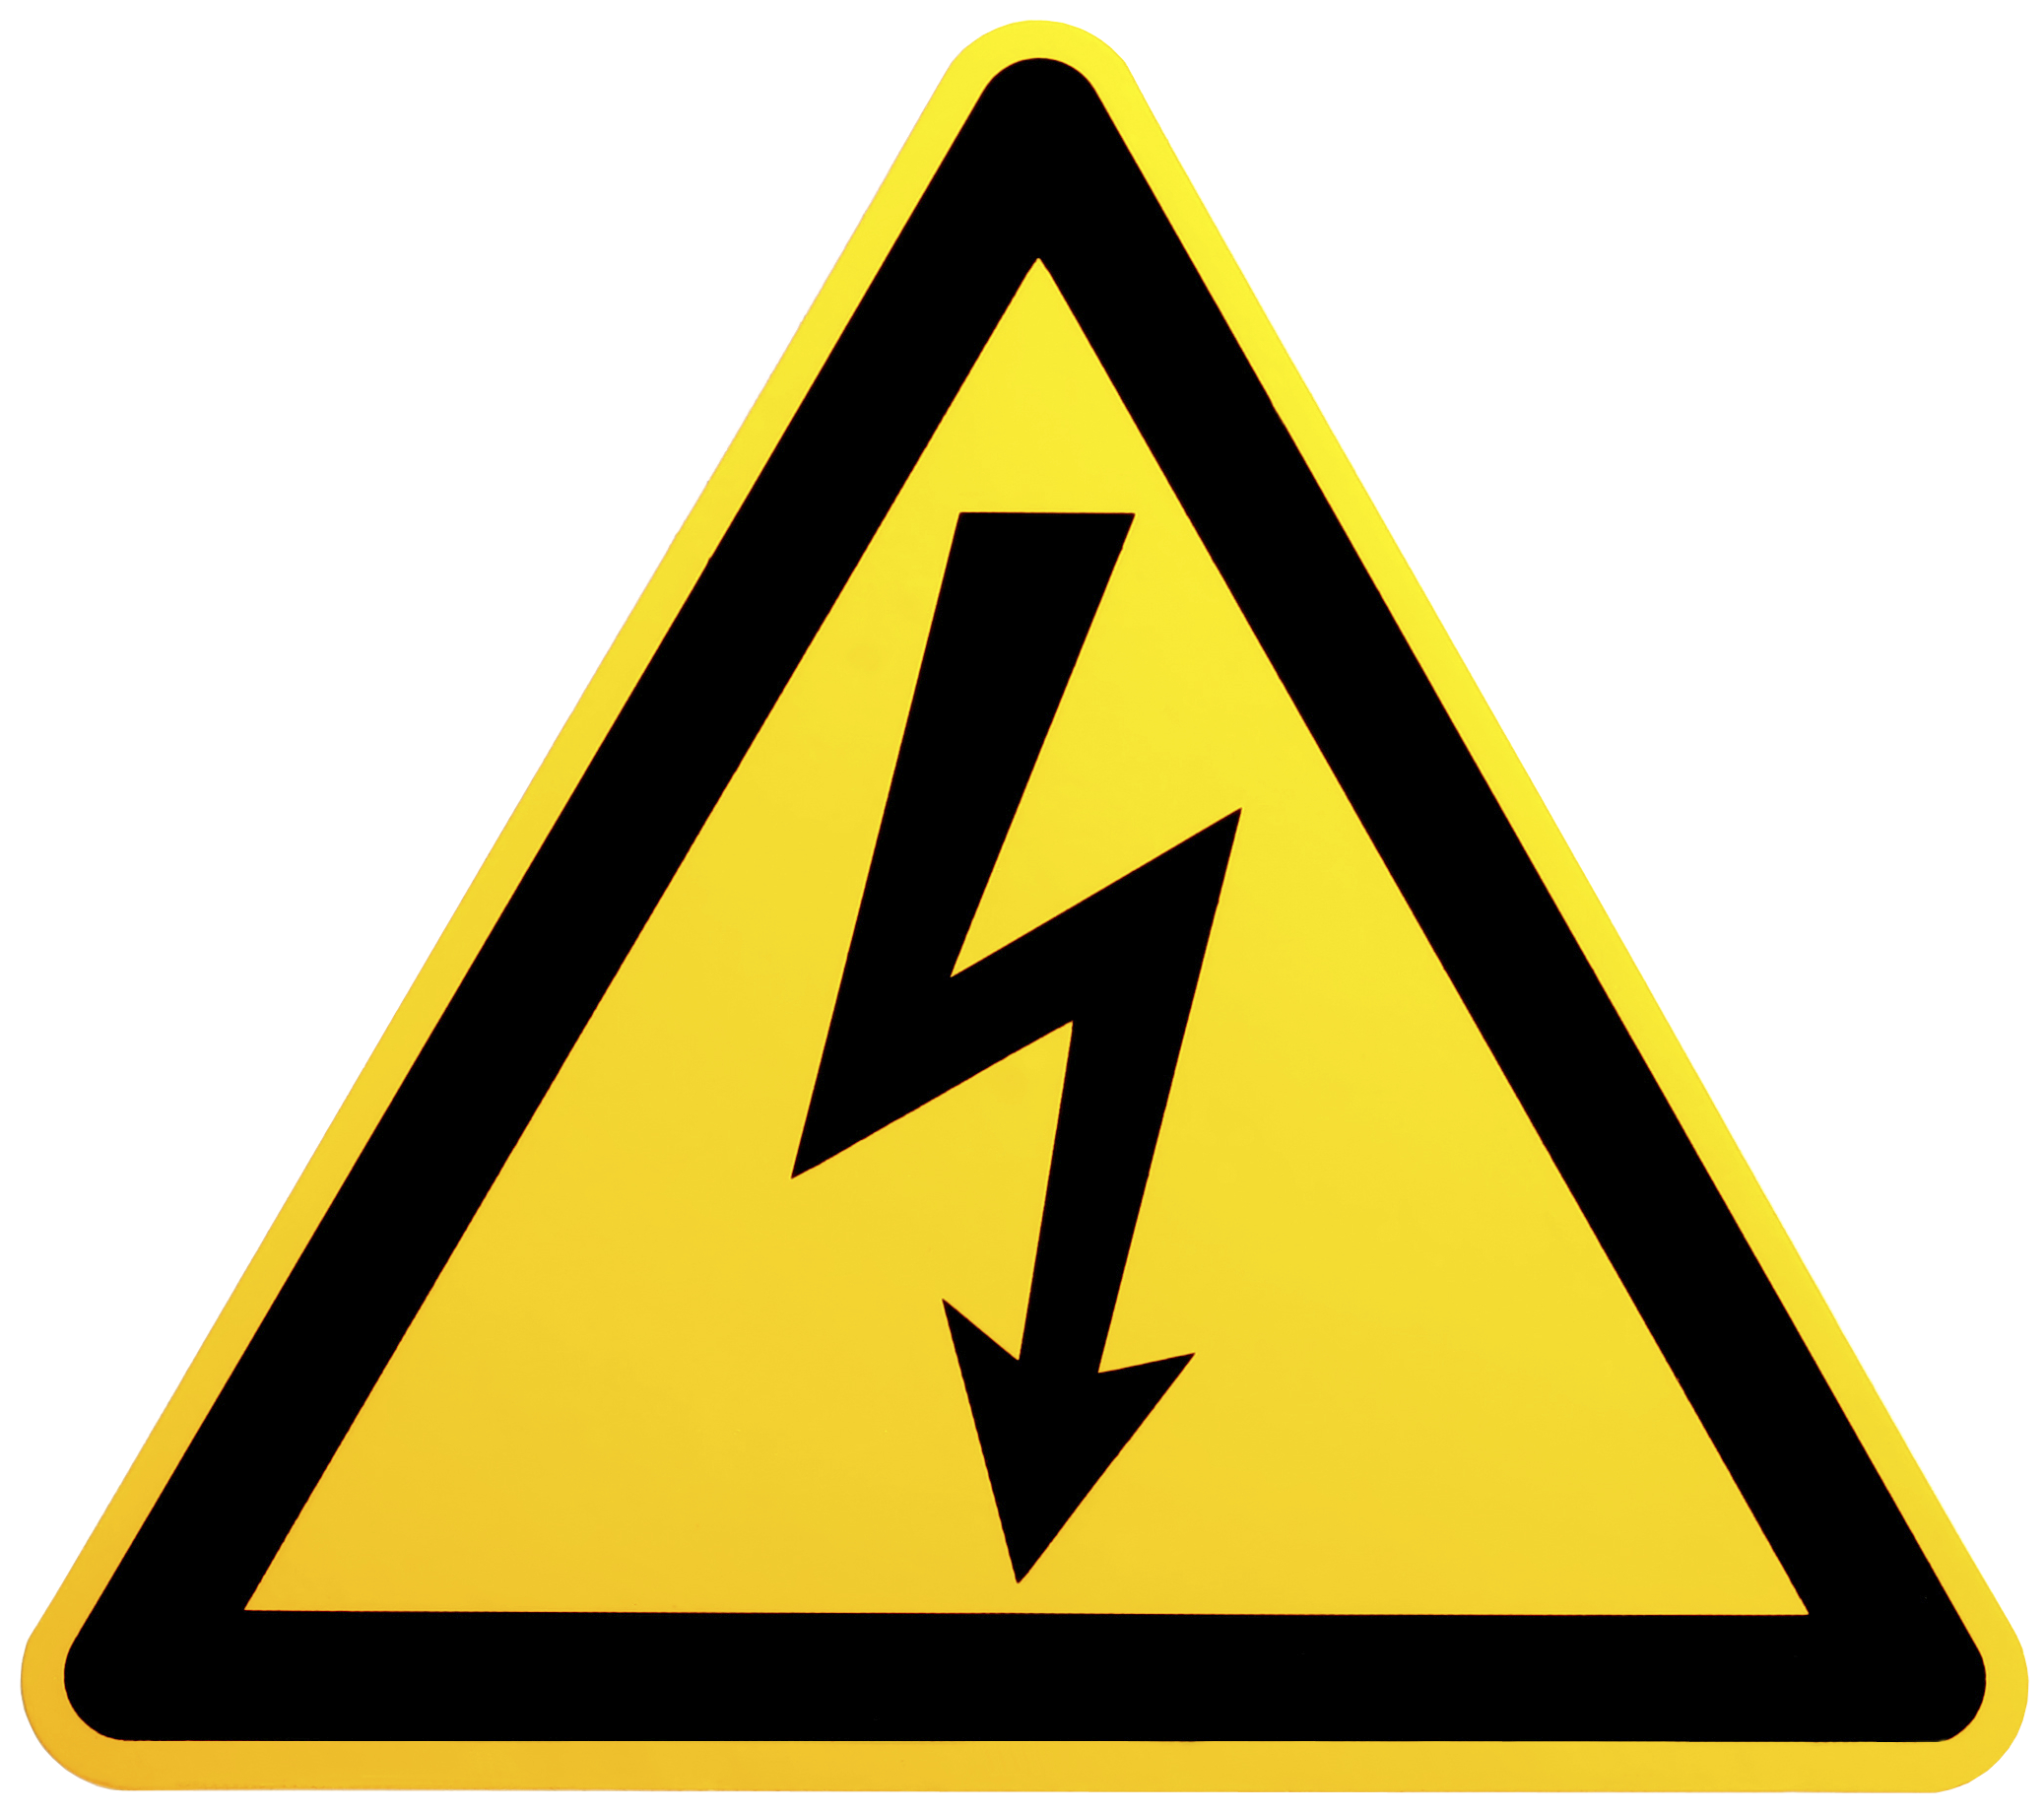
Electrical Hazards are Unique
Notes:
Now – On with the presentation…
As you are well aware, Electrical Hazards are receiving a LOT of attention of late. Why is that?
Are you experiencing a high level of electrical injuries here / at your facility?
-- What? NO???
-- Well thank goodness. And thank God you are not alone.

Slide 6
Electrical Hazards are Unique
Non-Fatal Occupational Injuries
0.16%
Electrical
U.S. BLS Economic News Release, 2010
Notes:
In fact, electrical injuries in the workplace are very RARE, despite all the attention they are receiving.
If Electrically Accidents cause just 0.16% of all “Non-Fatal Occupational Injuries.”
-- Just 0.16% of job-related injuries, are electrically related
-- That’s just a sliver of this line here on this Pie Chart!!!
Sprains and breaks make up the majority of non-fatal injuries [Blue]
-- followed by Falling off stuff [Red]
-- then getting hit by stuff [Green]
-- Then “Other” (watch out for “Other” – pretty dangerous) [Purple]
-- And then there’s the little black sliver… that’s electrical injuries… shocks and electrical burns… just 0.16% of all non-fatal injuries
This is why, when people say “we have never had an arc flash or shock injury here,” they are right… and they are not alone!
-- So why are even talking about this? It’s obviously not a big issue… right?

Slide 7
Electrical Hazards are Unique
#2
Burns
Shock
U.S. BLS Economic News Release, 2010
Notes:
Unfortunately, it is a big deal. As Lanny Floyd (of DuPont) points out: Electrical Hazards are unique in that have a “low frequency, of non-fatal injuries, but exceptionally high potential for fatal injury.”
You see, SHOCK is cited, by the Bureau of Labor & Statistics as the second leading cause of Lost-Time injuries
Burns are the #1 cause – and burns from shock and arc flash add to that category, but are not detailed out
So as we can see, even though electrically-induced injuries are rare, they are far more serious and disruptive than other categories of injury.

Slide 8
Electrical Hazards are Unique
#7
Transportation
Violence
Falls
Struck by…
Crushed
Exposure
Electrical
U.S. BLS Economic News Release, 2010
Notes:
Similarly, Electrically related injuries rank as the 7th leading cause of workplace fatalities in the U.S. (Cawley & Brenner)

Slide 9
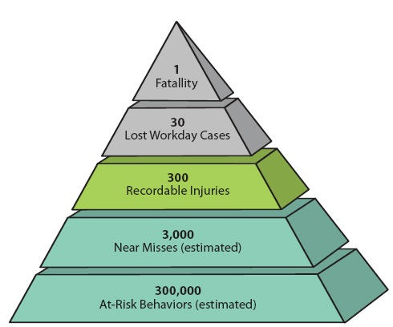
Electrical Hazards are Unique
300 : 1
Notes:
This is Hienrich’s Safety Pyramid. It was developed in the 1920s as a model to correlate “at-risk” behaviors with injury and fatalities
-- 30,000 at-risk behaviors will generate
-- 3,000 near misses, which in turn results in
-- 300 recordable injuries
-- 30 lost time incidents and ultimately
-- 1 fatality
Roughly a 10 to 1 ratio between typical injuries and fatalities
-- But with Electrical Hazards, this ration is actually 10:1
Electrical hazards are NOT typical of other safety hazards on the job site. They are far less frequent, but far more lethal.
-- as a result it is very common to meet resistance, based on the logic that “We’ve been doing it this way for 20 years and never saw any need to change!”

Slide 10
Electrical Hazards are Unique
300 : 1
10 : 1
Electrical
Notes:
Now if we look at Electrically-related injuries, we see
-- NOT a 300:1 ratio
-- But a 10:1 ratio – for every 1 in every 10 electrical injuries will result in a fatality
Electrical hazards are NOT typical of other safety hazards on the job site. They are far less frequent, but far more lethal.
-- as a result it is very common to meet resistance, based on the logic that “We’ve been doing it this way for 20 years and never saw any need to change!”
-- But that logic fails to hold up as soon as that facility is met with an incident, because it is very likely to be serious, if not fatal.
It’s kind of like the jack in the box (what sadistic person thought that one up by the way???)
-- Everything’s going along fine (ding-d-ding-d-di-ding-d-ding…)
-- And then…

Slide 11
Electrical Hazards are Unique
Notes:
Now if we look at Electrically-related injuries, we see
-- NOT a 300:1 ratio
-- But a 10:1 ratio – for every 1 in every 10 electrical injuries will result in a fatality
Electrical hazards are NOT typical of other safety hazards on the job site. They are far less frequent, but far more lethal.
-- as a result it is very common to meet resistance, based on the logic that “We’ve been doing it this way for 20 years and never saw any need to change!”
-- But that logic fails to hold up as soon as that facility is met with an incident, because it is very likely to be serious, if not fatal.
It’s kind of like the jack in the box (what sadistic person thought that one up by the way???)
-- Everything’s going along fine (ding-d-ding-d-di-ding-d-ding…)
-- And then…

Slide 12
Hazard v/ Risk
Notes:
Now let’s take a look at the concepts of Hazard and Risk.
For years these concepts were muddled together in NFPA 70E
-- Remember the “Hazard/Risk Category” or HRC?
-- Every other safety standard kept these two concepts separate, but we managed to merge and confuse them
-- Well that’s changed now, and the last couple revisions have worked to separate the two concept
Let’s have a look…

Slide 13
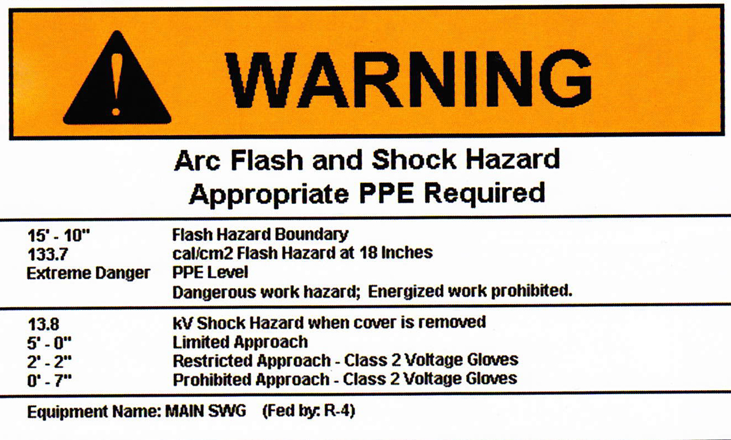
Hazard & Risk
Hazard:
“A source of possible injury or damage to health.”
NFPA 70E-2015; Article 100
Notes:
By definition, a Hazard is the SOURCE of possible injury or damage to health.
So a Hazard is something we IDENTIFY – ie. a “Shock Hazard” or an “Arc Flash Hazard”

Slide 14
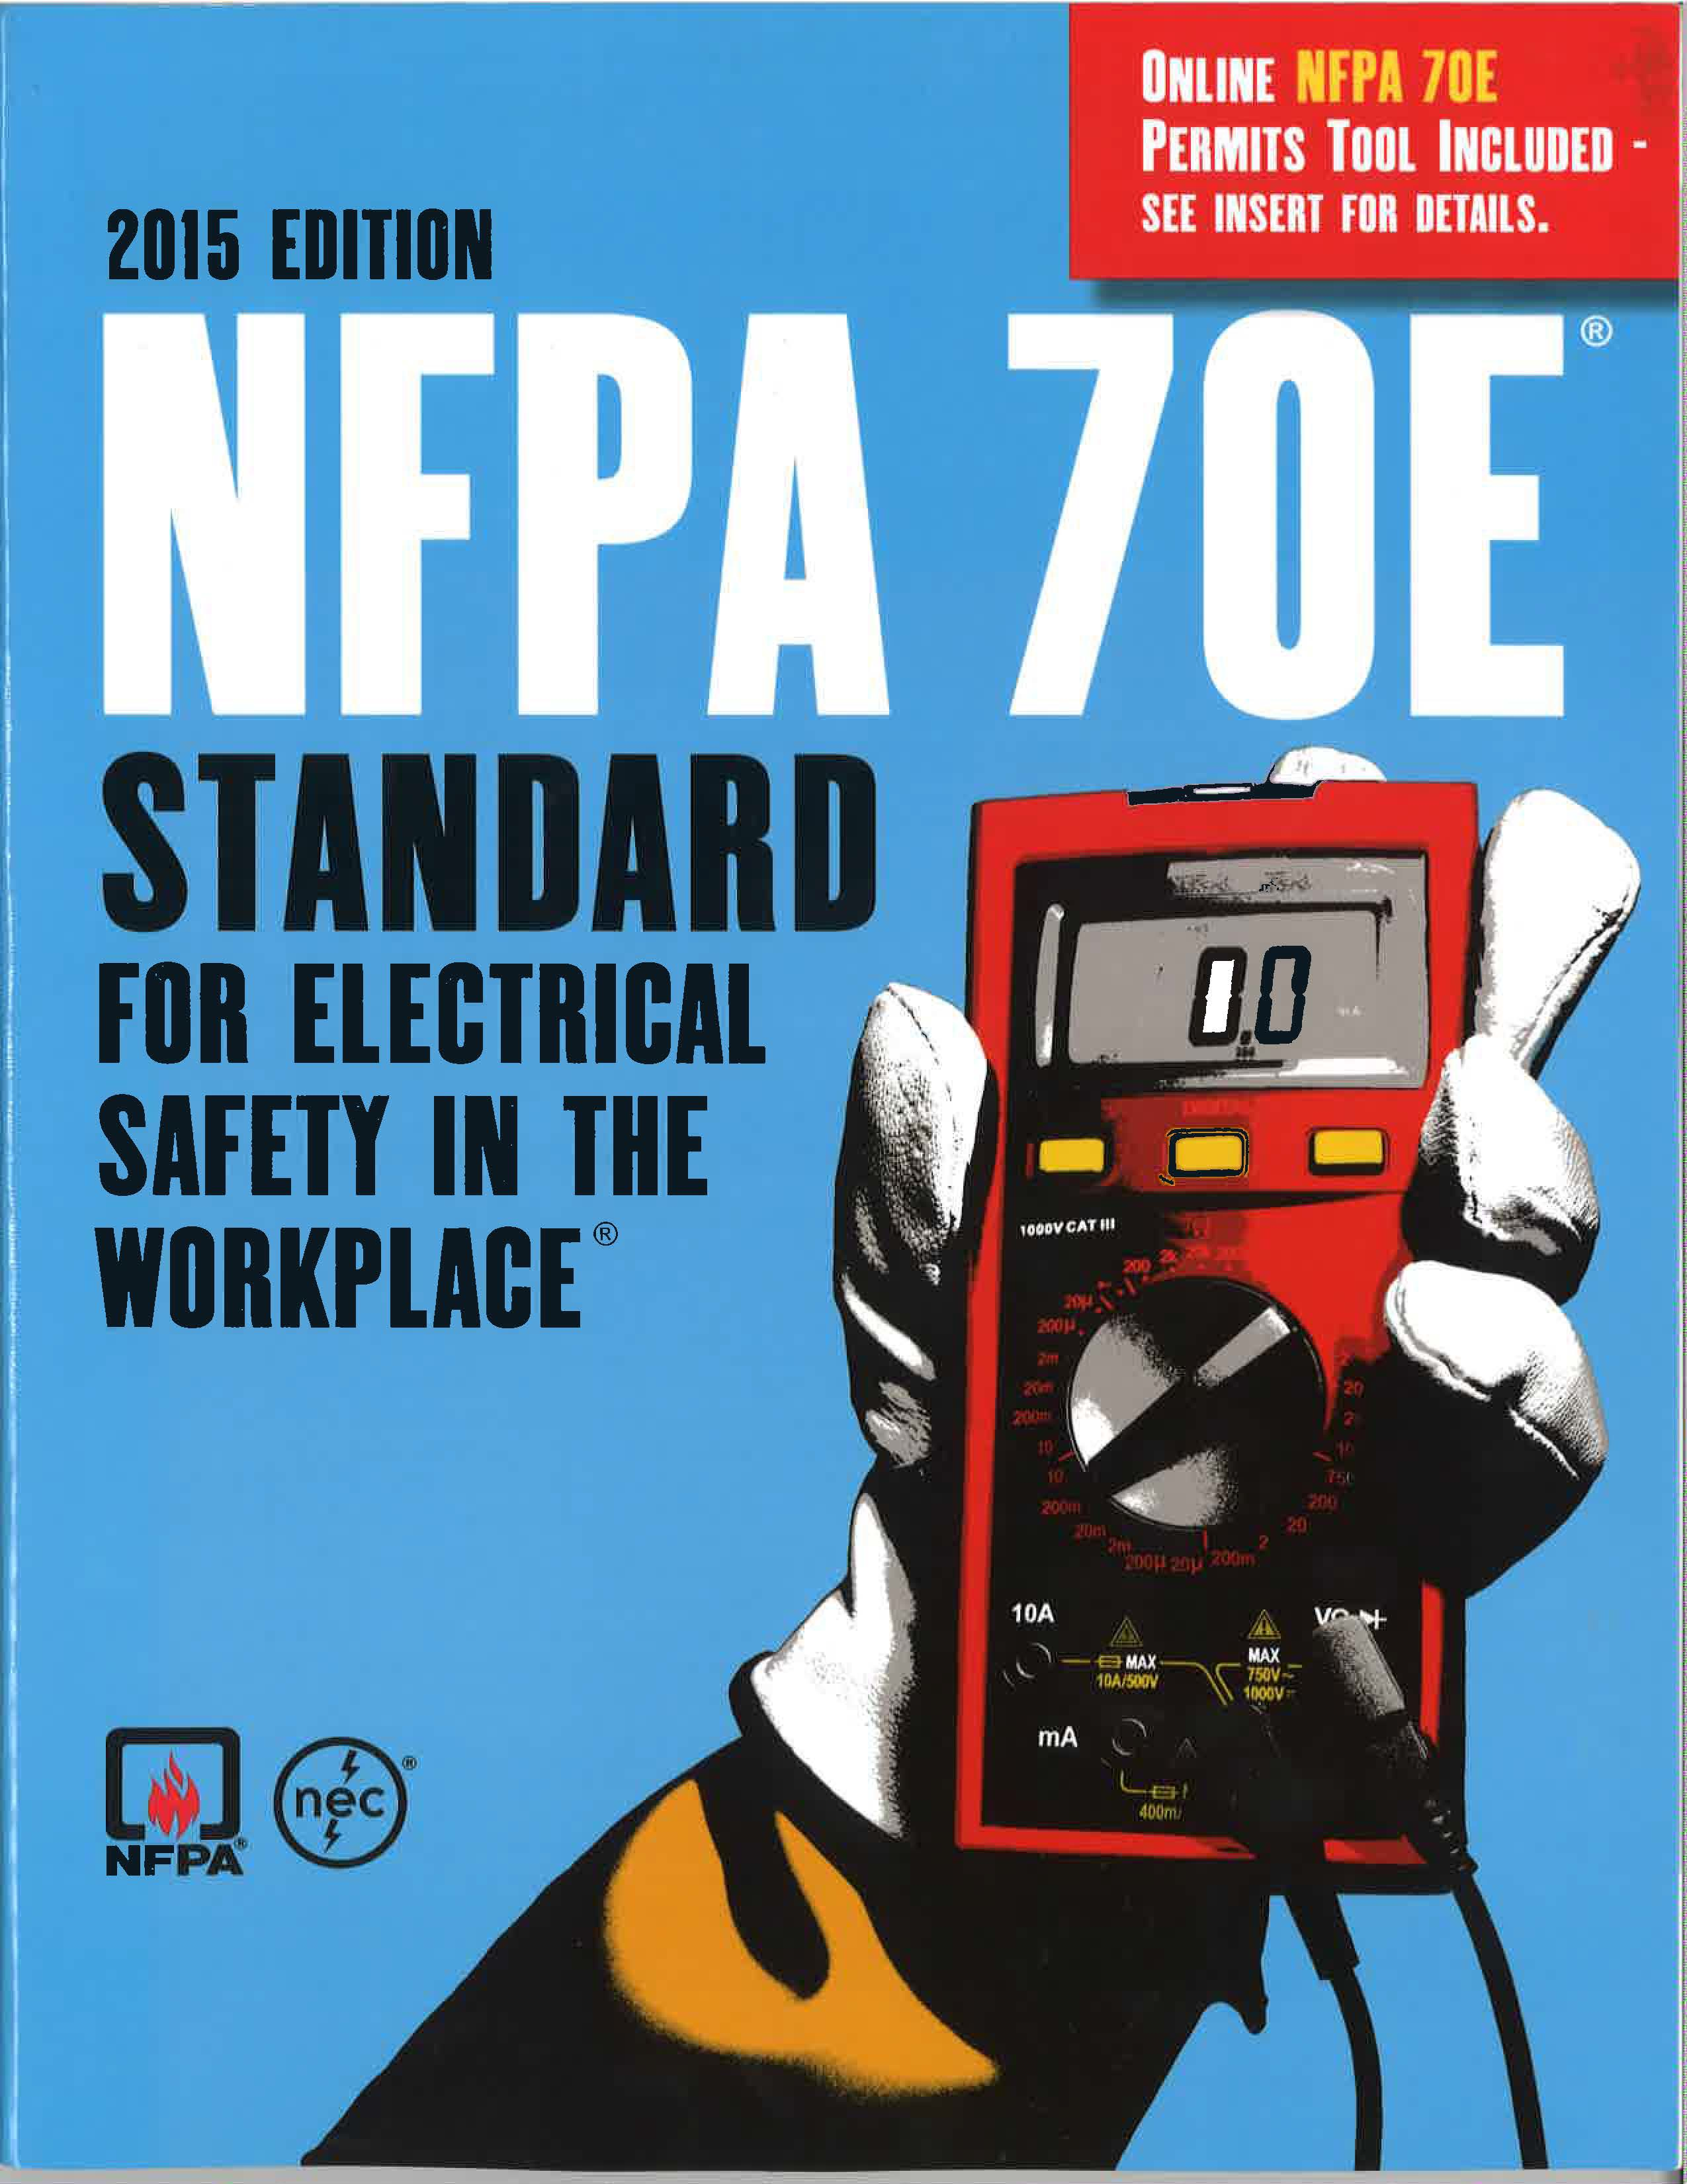
Hazard & Risk
Risk:
Refers to a combination of both the likelihood of injury occurrence and the severity
NFPA 70E-2015; Article 100
Notes:
By Definition, a RISK refers to a COMBINATION of both the LIKELIHOOD of injury occurrence… and the SEVERITY
So a RISK is something we ASSESS -- as in an “Arc Flash Risk Assessment.”
-- You will notice that the SEVERITY part of the ARC FLASH RISK ASSESSMENT is done for you by quantifying an listing the Cal/cm2 of the potential arc flash in on the Arc Flash Risk Assessment Label.
-- Similarly, if Arc Flash Risk Assessment Labels are not available, the tables in 70E prescribe PPE levels based on equipment class
-- You will find two other tables in 70E that help to assess the LIKELIHOOD part of risk:
-- One that requires the worker to consider the likelihood that a task will trigger an arc, and then to consider the installation, maintenance and condition of the equipment prior to performing that task.
-- Another table that helps the worker to gauge working distances from exposed conductors to reduce the likelihood of shock hazard at various voltages

Slide 15
Hazard v/ Risk
Notes:
Now let’s take a little quiz:
This NOT my wife, although it very well could be based on the way she appears to be driving.
In this picture, what is Hazard & what is Risk?
-- The Hazard here is a car crash… or the inertia / crash energy that would be generated
-- The Risks are her reckless behaviors, road conditions, vehicle condition, speed, etc.
-- …Those things that could influence or cause the release of that crash energy.
Now let’s look at ways that we can keep ourselves safe… FROM HER

Slide 16
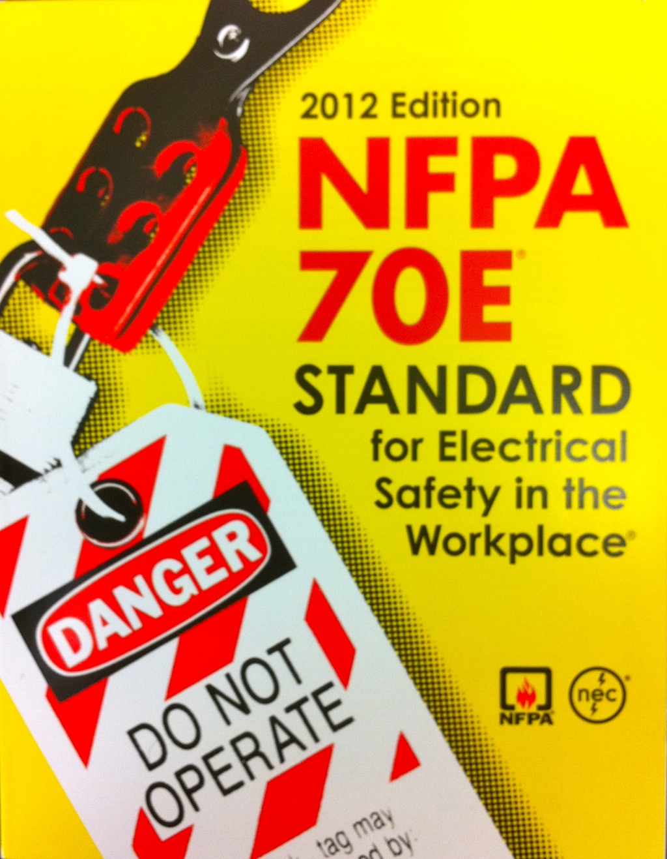
Hierarchy of Risk Control
Hazard Elimination
Substitution
Engineering Controls
Warnings
Administrative Controls
PPE
ANSI Z10
Notes:
ANSI Z10 is a foundational document at the heart of practically all safety standards. It is referenced throughout NFPA 70E and CSA Z462.
-- One of the things it seeks to do is systematize safety and make it a “manageable” science
-- The Hierarchy of Risk Controls (in ANSI Z10 & referenced in 70E Annexes) is a systematic method of controlling risks to protect personnel
-- Note it is a HIERARCHY of Risk Control – not a random list
-- That means that the higher order controls are MORE EFFECTIVE at controlling risk than are lower orders
-- It lists these controls from most effective (coincidently most proactive), to least effective (coincidently more reactive)
-- This is not to say that any of the controls are more or less IMPORTANT than the others, even the lowest order of control, while least effective, is critically important if it is your last line of defense.
OK – So what is the most effective way NOT to get injured a car crash with that girl? That’s right – Don’t get in the car!!! We call that “ELIMINATING THE HAZARD”
-- What do we call this in the world of electrical safety? Deenergize, that’s right… turn the gear OFF. It’s actually the first and most important (and overlooked) directive in 70E.
Now if you can’t Eliminate the hazard, you are going to use a suite of the following 5 controls, with emphasis on the higher orders where possible.
#2: We can’t stay in bed our whole lives though, can we? No. We need to drive to work. So when we do, we substitute the hazard with a lower form of the hazard. When we are in the city or around neighborhoods we have higher likelihood of a crash so do we drive faster or slower – we drive slower because in the even the we release the hazard, it will be a lower crash energy.
-- In our business we Substitute by using AUTOMATED RACKING & UNRACKING, right. That way we can set the robot up in front of the breaker, walk 50 feet to the end of the line-up, and rack or unrack – a very dangerous task. But by increasing working distance we decrease energy exposure, right?
#3: The third most effective way to mitigate risk is with engineering controls. What are these in your car? Crumple zones to redirect energy, seatbelt, airbags, anti-lock breaks, etc. Now engineering controls are not as sure-fire as reducing speed, but they are no less important.
-- What are some examples of this in our world? Arc resistant switchgear, current limiting fuses, high-speed relays, high-resistance grounding…
#4: Less effective, but no less important are warnings – speed limits, curve ahead, yield…
-- Anyone see these Arc Flash Risk Assessment Labels going up on all the electrical equipment now, warning of the hazards?
#5: Administrative controls – we send our kids to Driver’s Ed classes, we have traffic laws, etc
-- In the electrical world, we have Energized Work Permits, 70E, arc flash classes, etc
#6: So what’s the LEAST effective way to protect yourself? PPE. Nascar drivers wear PPE because they are driving at high risk, right? And we use PPE when we have to work energized. But it the least proactive method, basically saying “OK arc flash, give me everything you’ve got, I have my magic fabric to protect me.” Now don’t get me wrong – PPE is critically important… as your LAST LINE of DEFENSE. It saves lives every day, but wouldn’t you be better off avoiding the hazard by eliminating it?
Now let me ask you – where did your company spend it’s money 1st? (PPE)
And then they probably paid for training?
And then the arc flash stickers?
Why are we starting at the bottom when we are supposed to use top order controls?

Slide 17
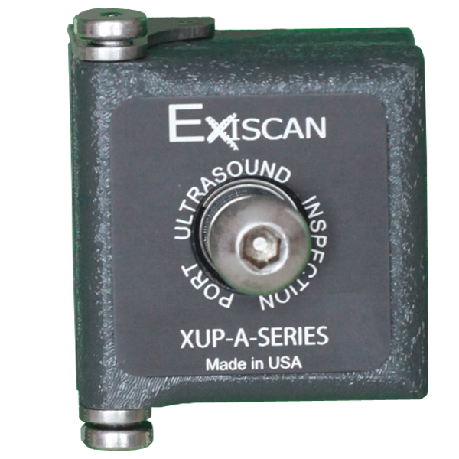
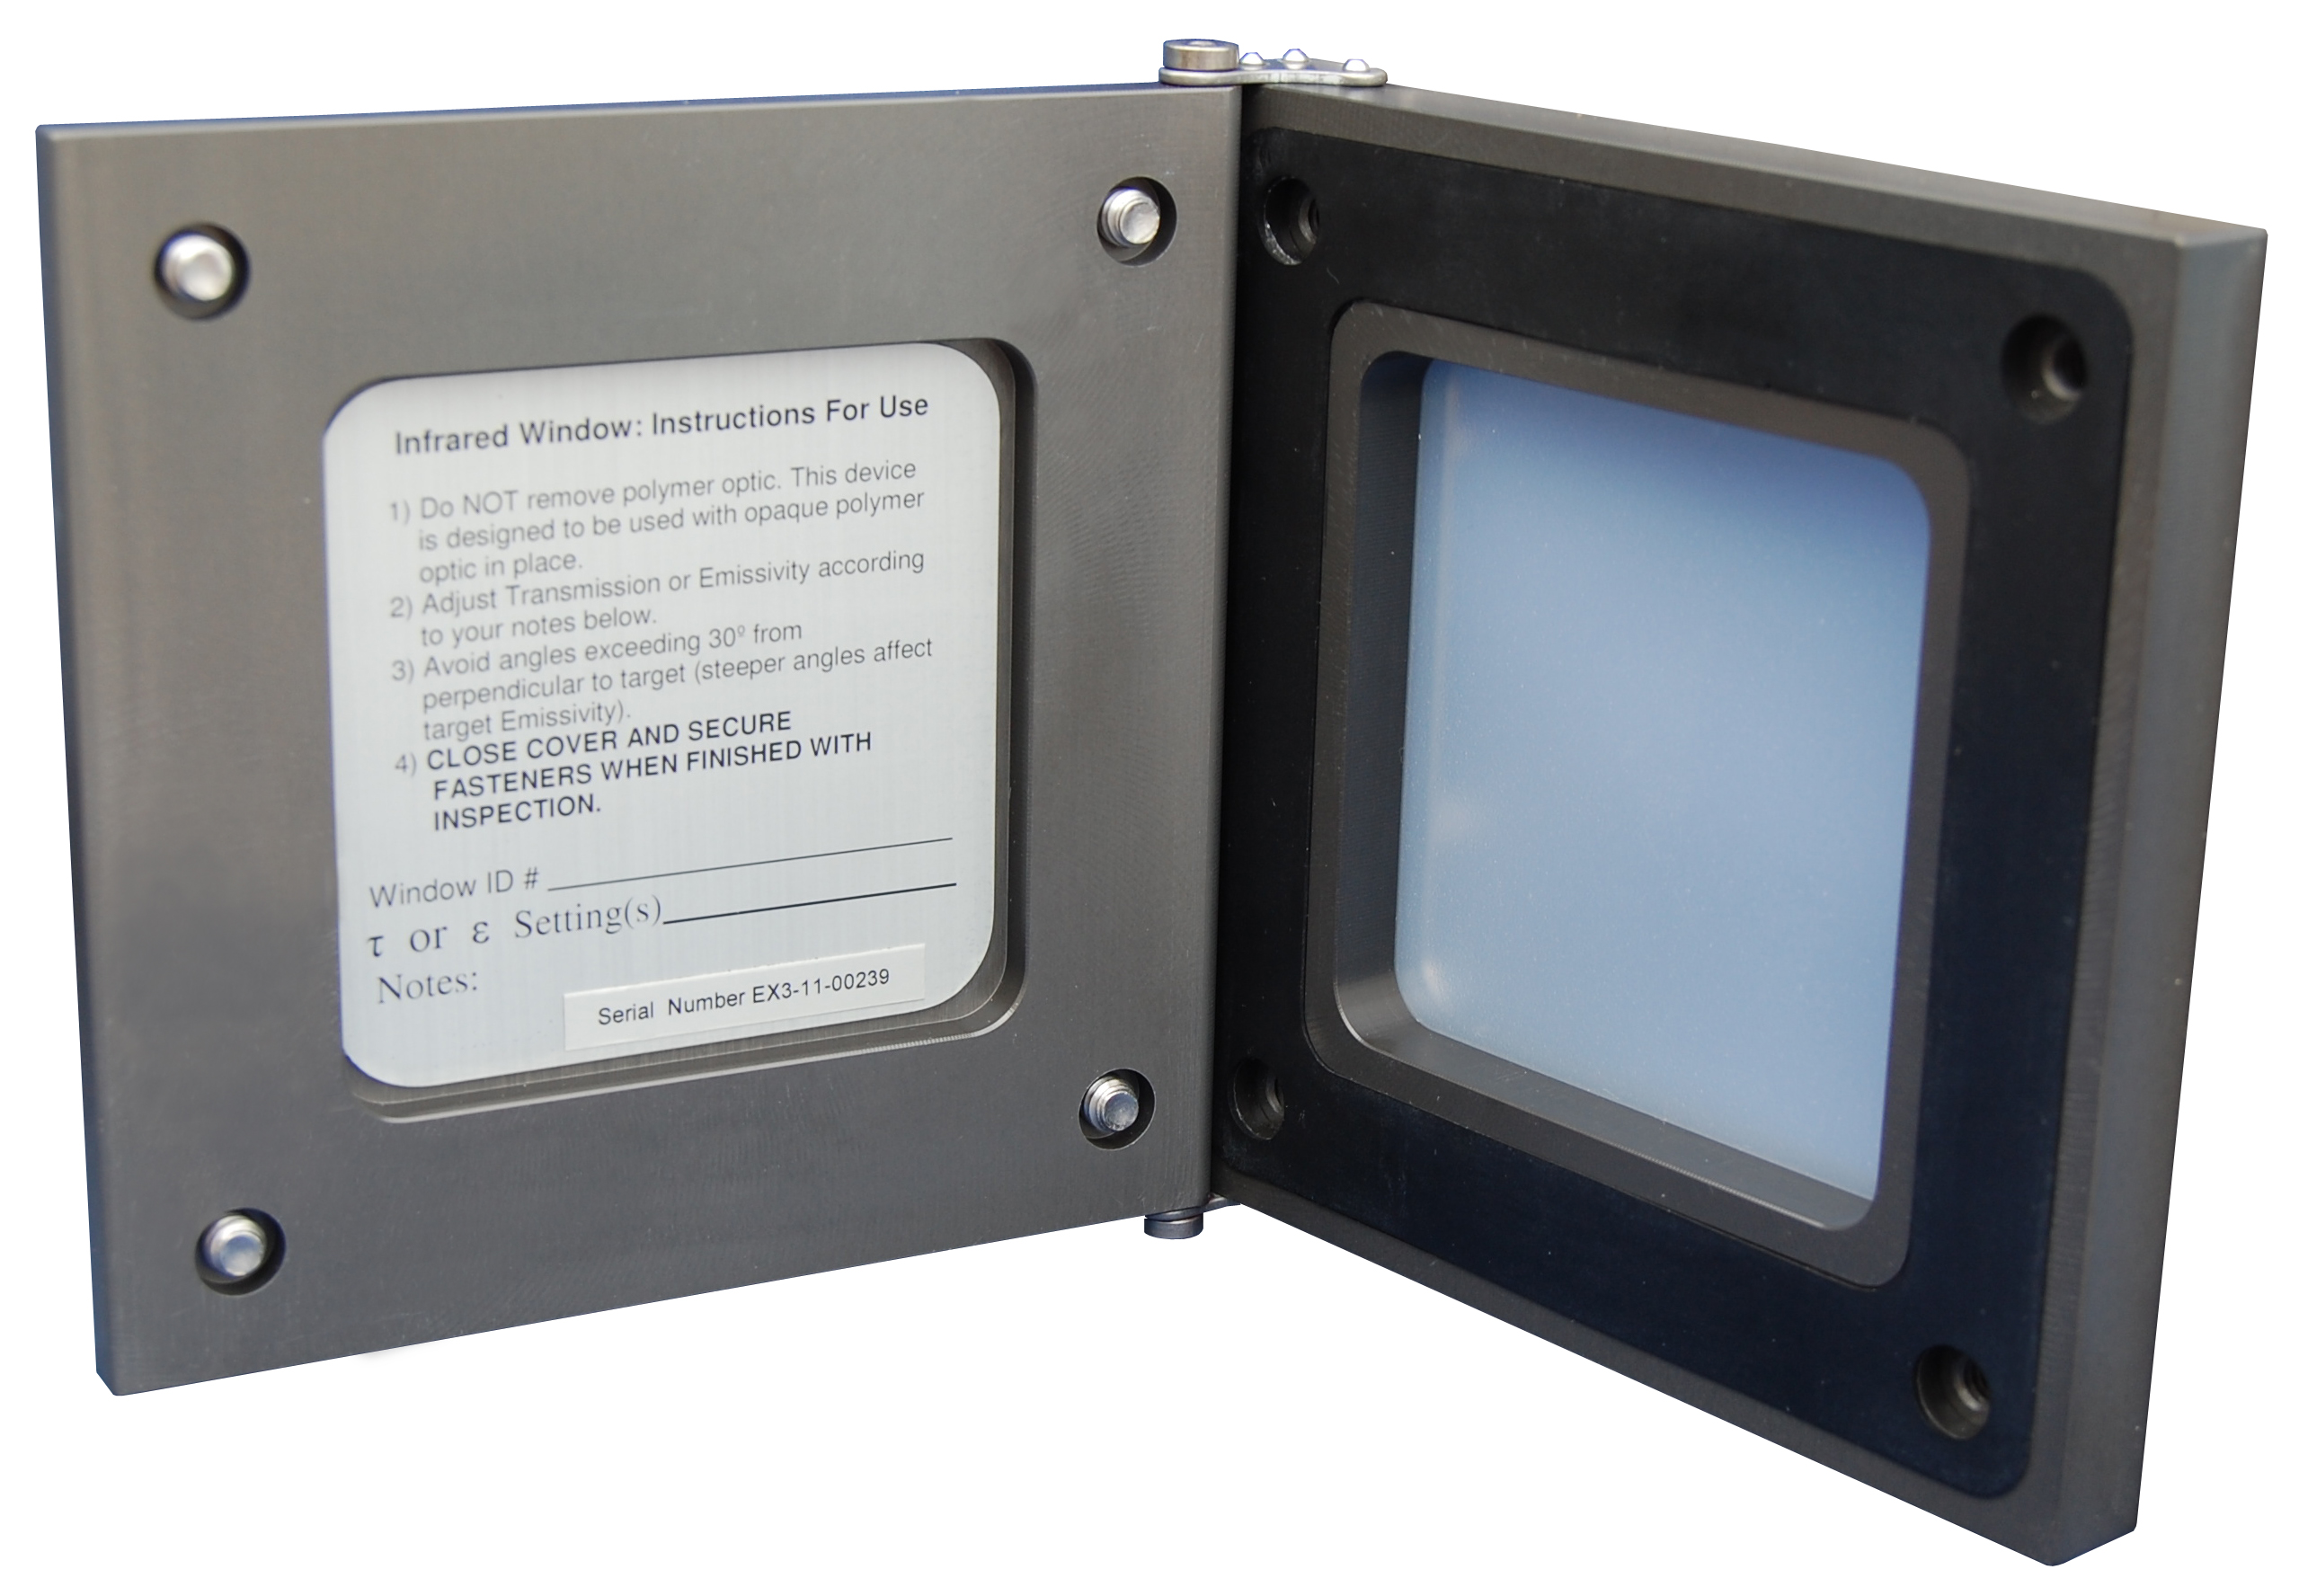
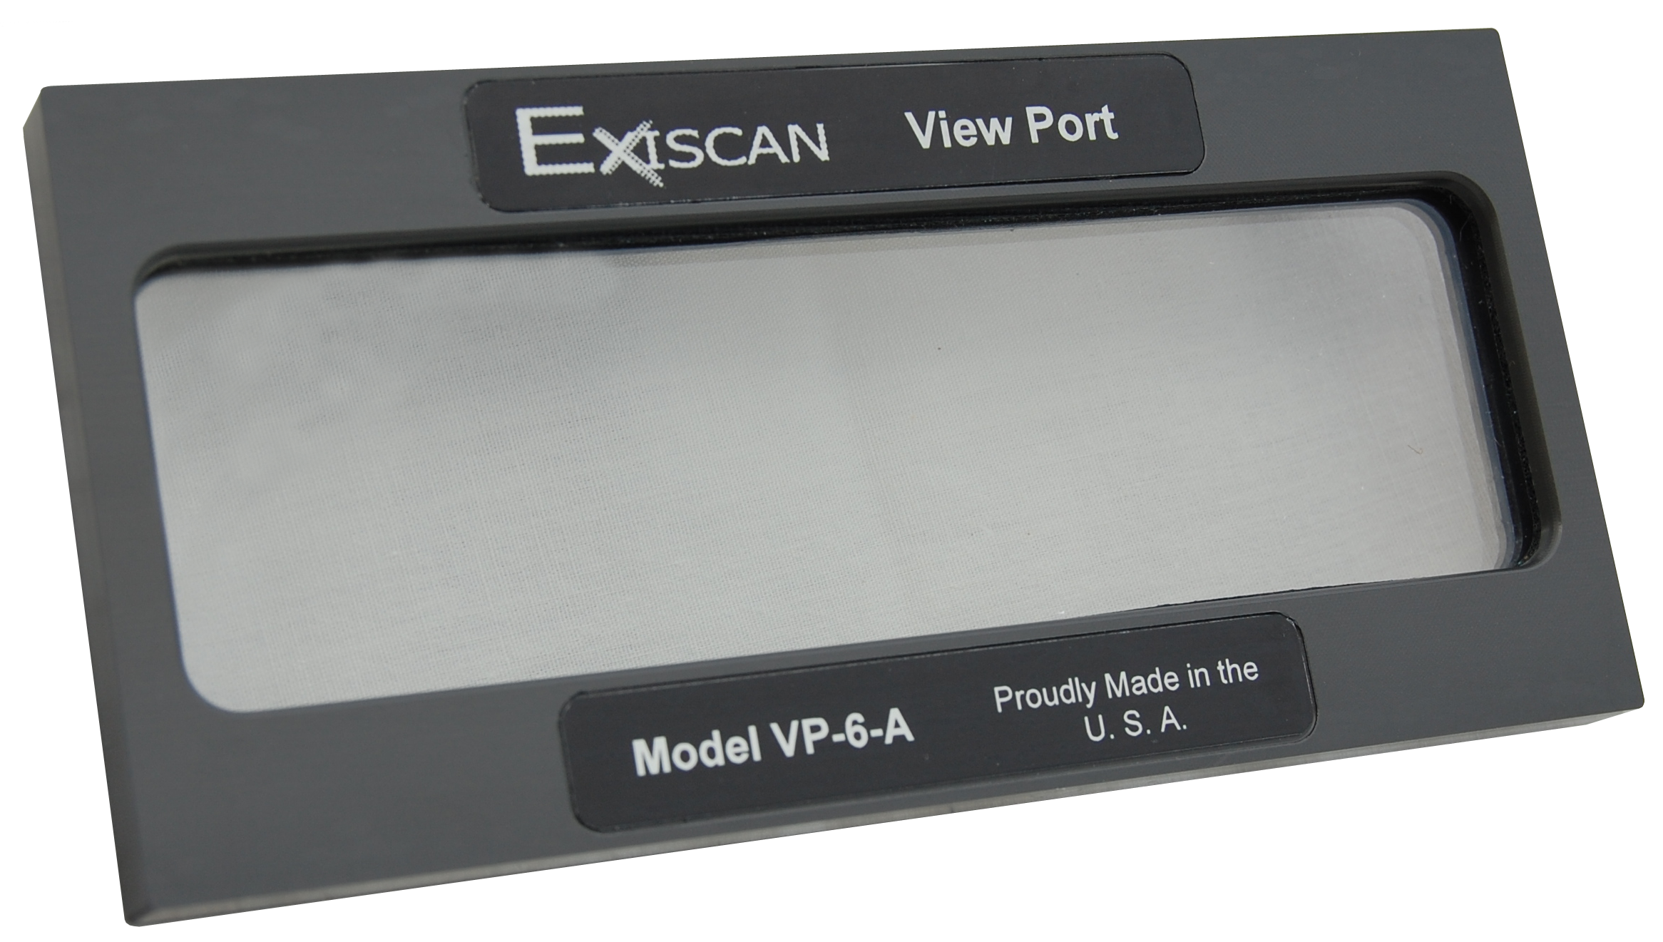
Closed-Panel Inspection
Eliminated Hazardous Tasks
Notes:
So where do closed-panel inspection windows fall on that hierarchy?
-- IR windows, visual inspection windows, ultrasound ports…
-- They ELIMINATE the hazardous work tasks, so they are the top order controls.
-- Why open the panels or doors – one of the most dangerous tasks you can do, risking triggering a blast?
-- Why not eliminate the inherently high-risk tasks and not risk triggering the blast?

Slide 18
Summary
Electrical Hazards & Risks are Unique
Use Higher Order Risk Controls
Design Work Inherently Safer Processes

Slide 19
Thank You!

